Slide 1

Theory Of App Development
(CSBB 352)
Members
HIMANSHU JOSHI (221210048)
KASHIKA (221210057)
SHIVA (221210058)

Slide 2
Travel Sathi : Your Guide, Matchmaker, and Trusted Companion
Why ?

Slide 3
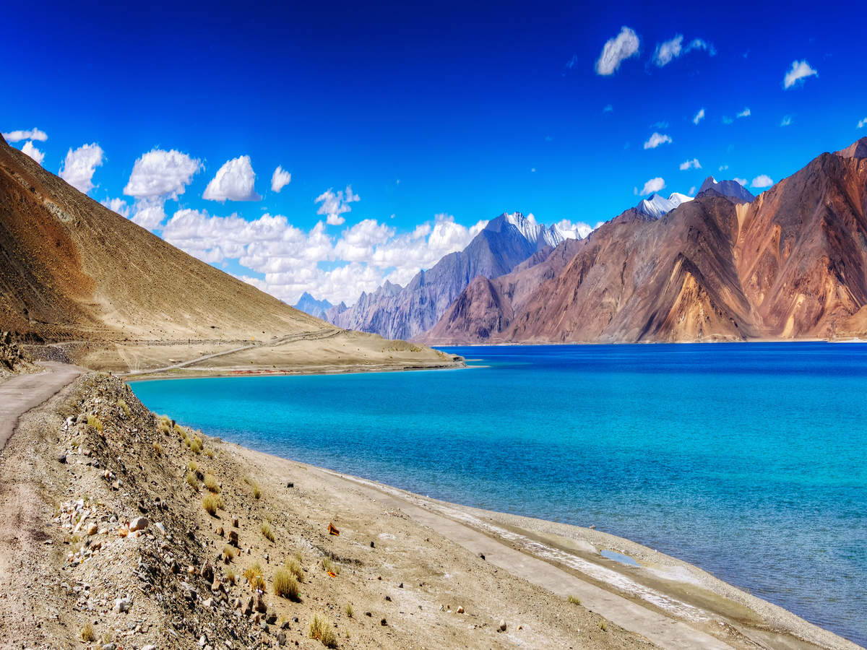

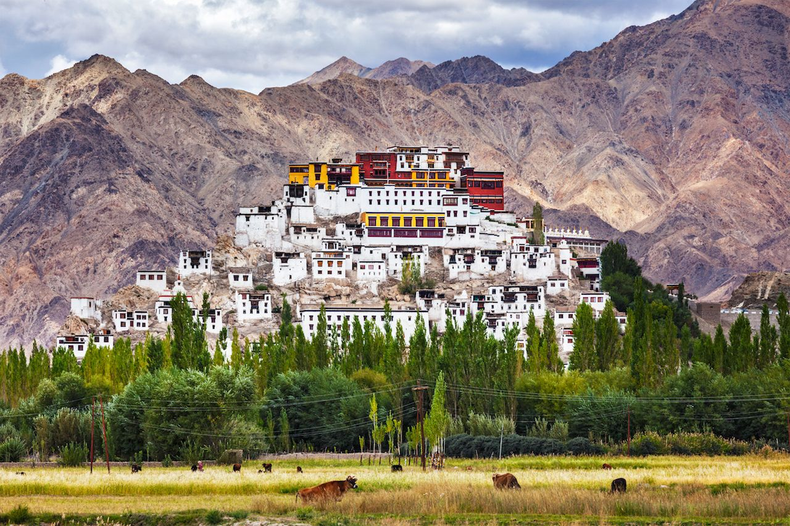
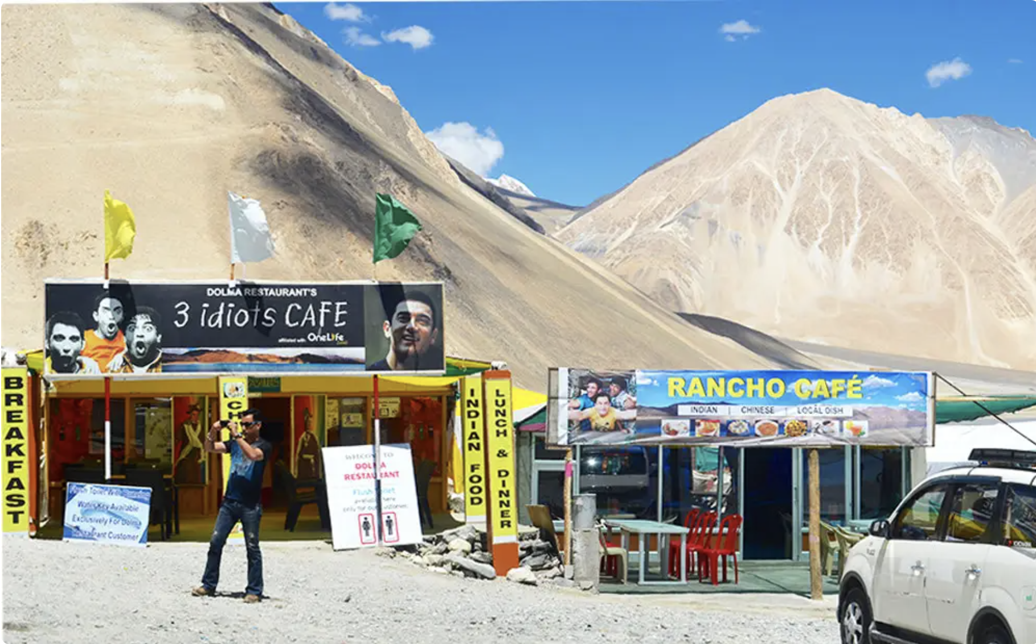
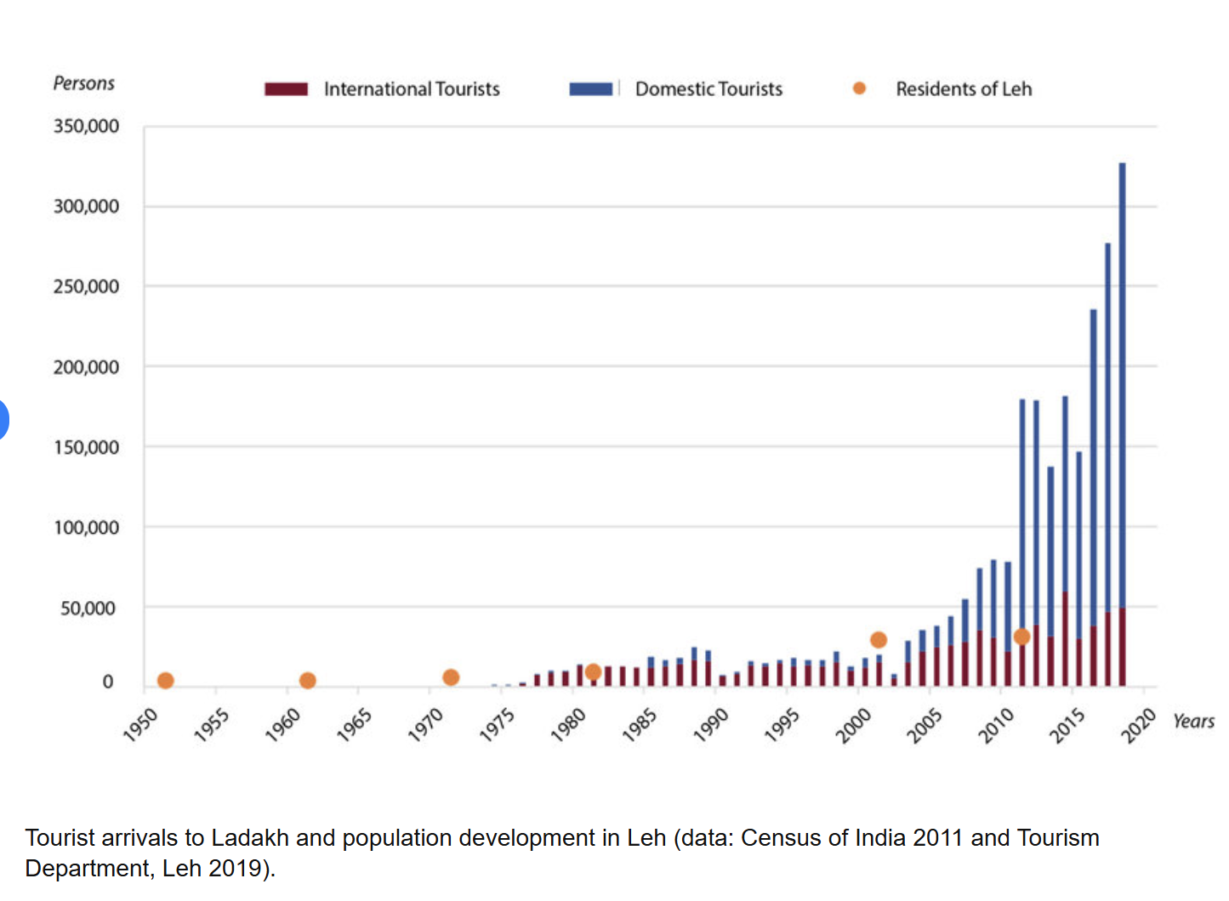
Ladakh and 3 idiots :
Case study 1

Slide 4
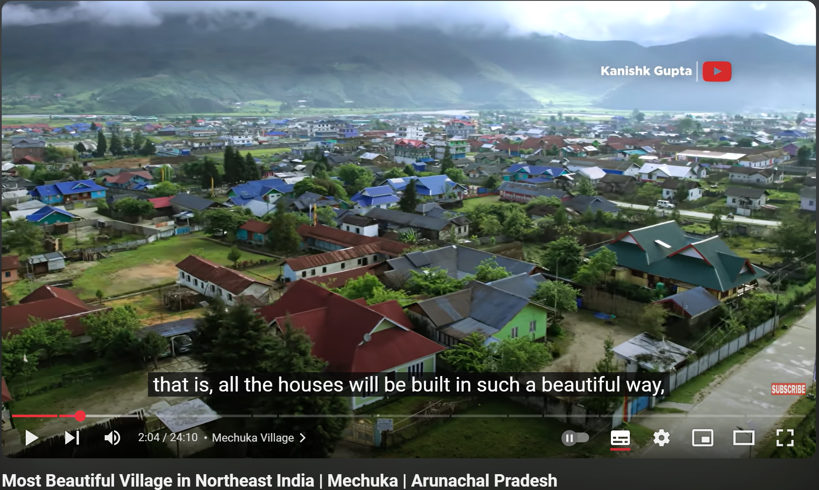
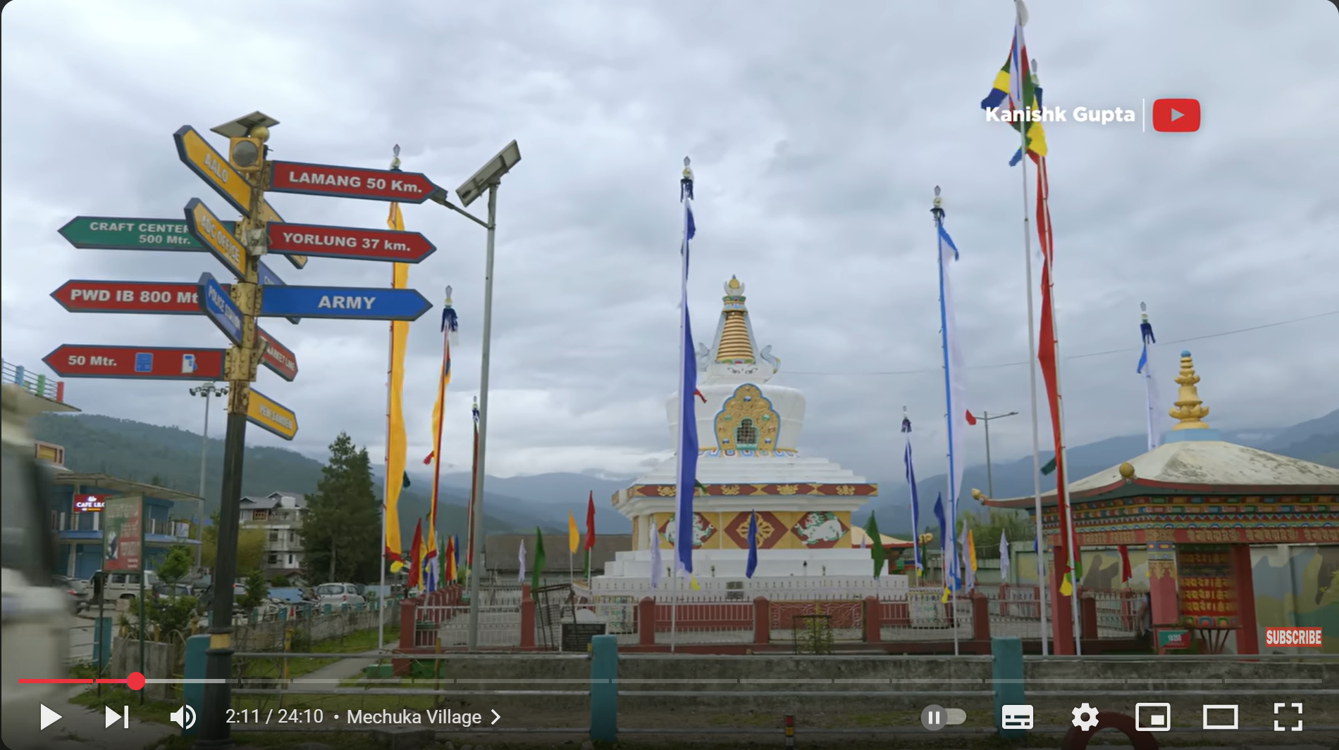
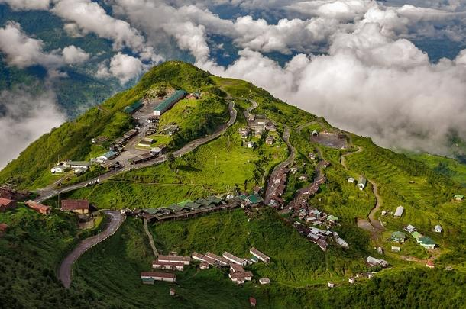
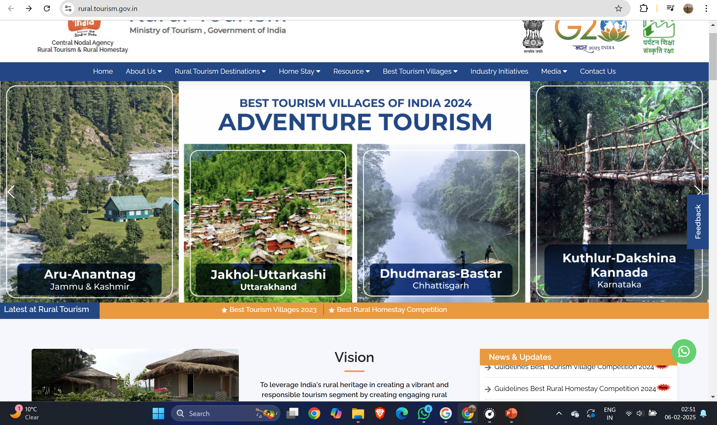
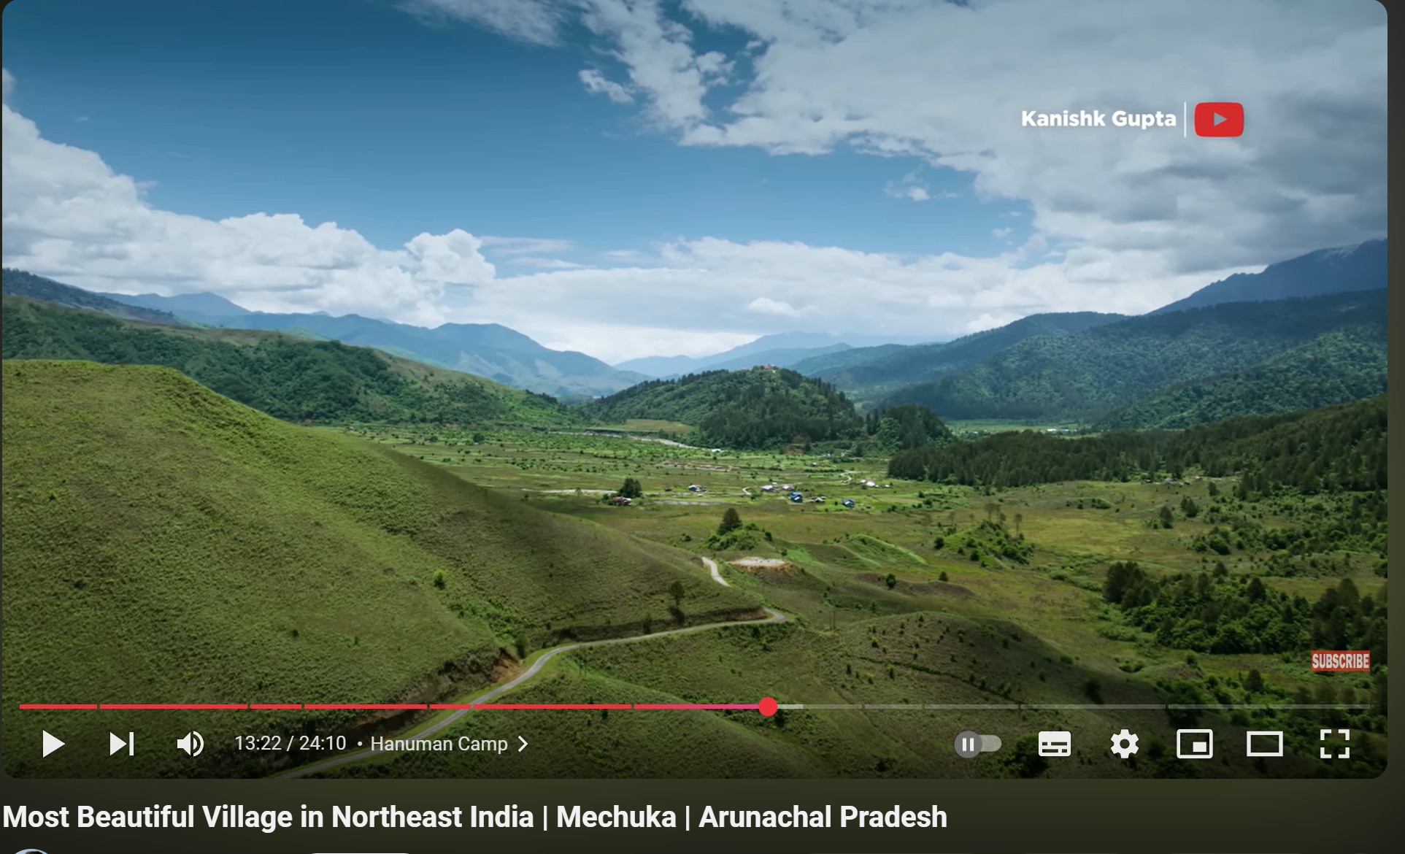
How it is related ?

Slide 5
The Gap in Authentic Village Tourism
Challenges or problems in accessing and planning genuine rural travel experiences.
Lack of Reliable Information
Missed Community Interactions
Village destinations, cultural experiences, and authentic homestays lack visibility. Finding verified and secure booking options is difficult.
There's no dedicated platform for interacting with rural communities. This limits opportunities for cultural immersion and sustainable tourism.

Slide 6
Challenges for Solo Travelers and Activity Planning
Issues faced by solo travelers and those searching for activity pricing and facilities.
For Solo Travelers:
For Activity Planning:
Difficulty in Finding Companions: Lack of platforms to connect with like-minded travelers.
Complex Travel Planning: Planning activities independently can be overwhelming due to a lack of user-friendly comparison tools for tour agencies and inconsistent pricing.
Challenges in planning independent trips: Difficulty in coordinating itineraries and logistics.
Lack of Transparency: Difficulty in comparing prices and services across different providers.

Slide 7
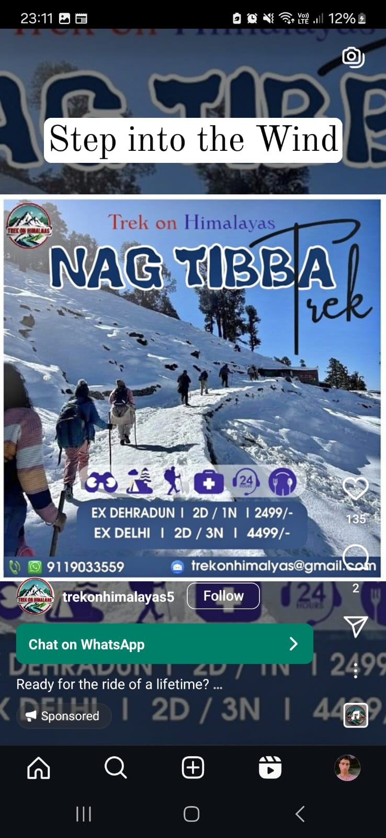
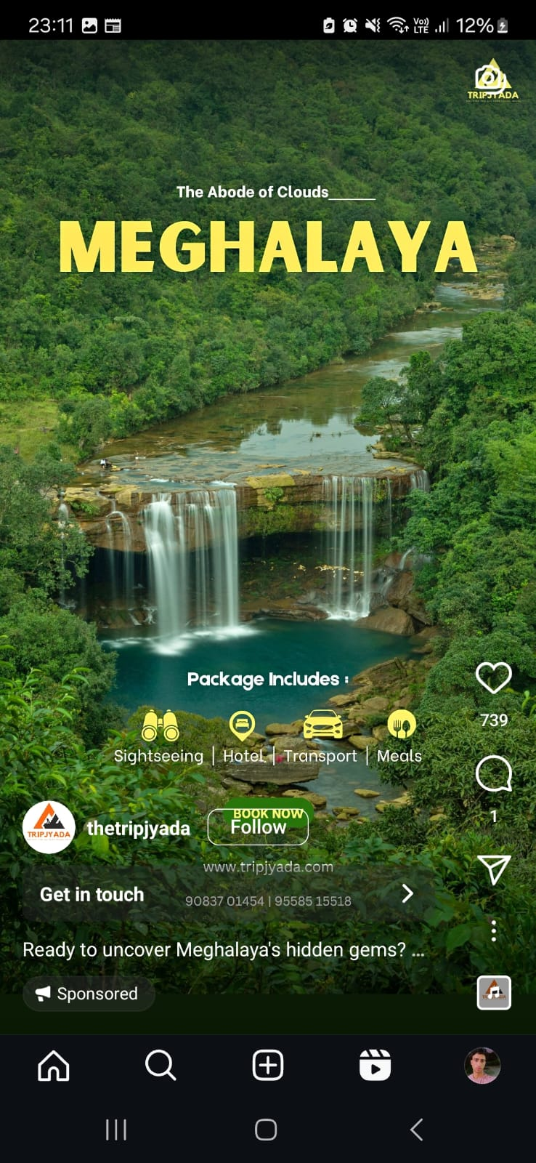
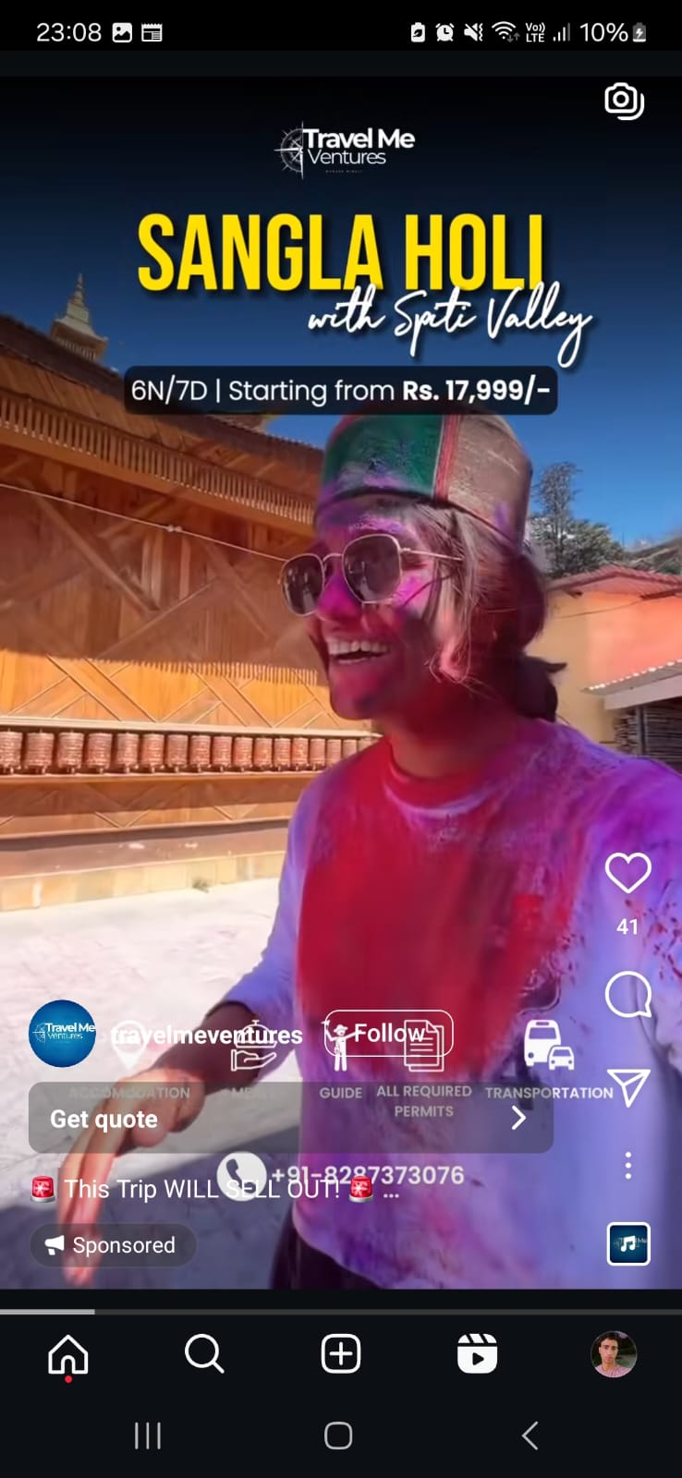
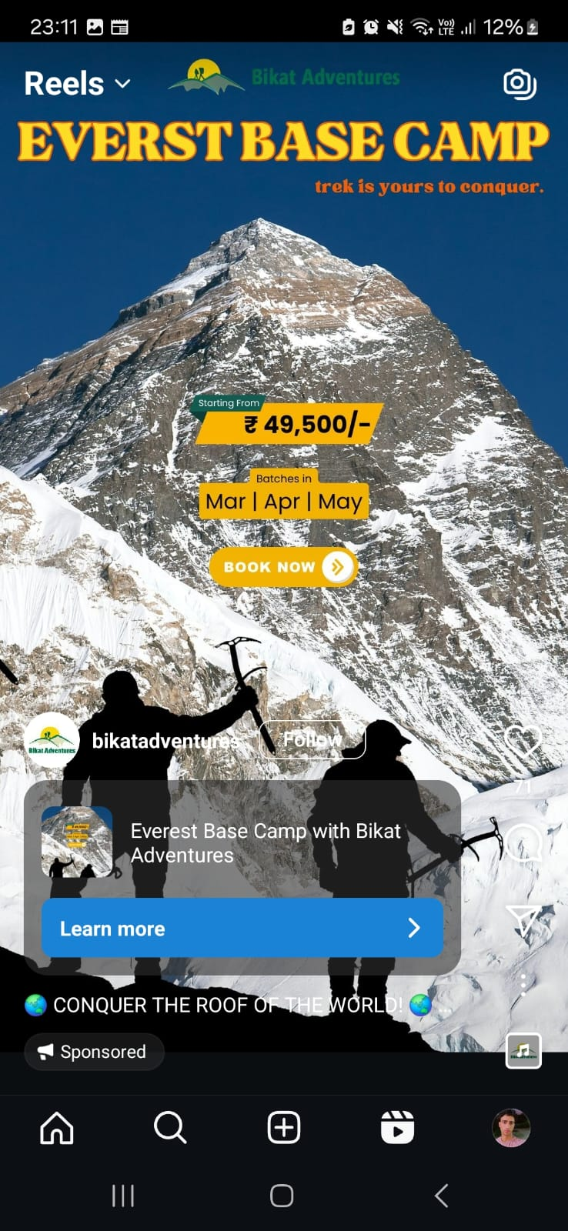
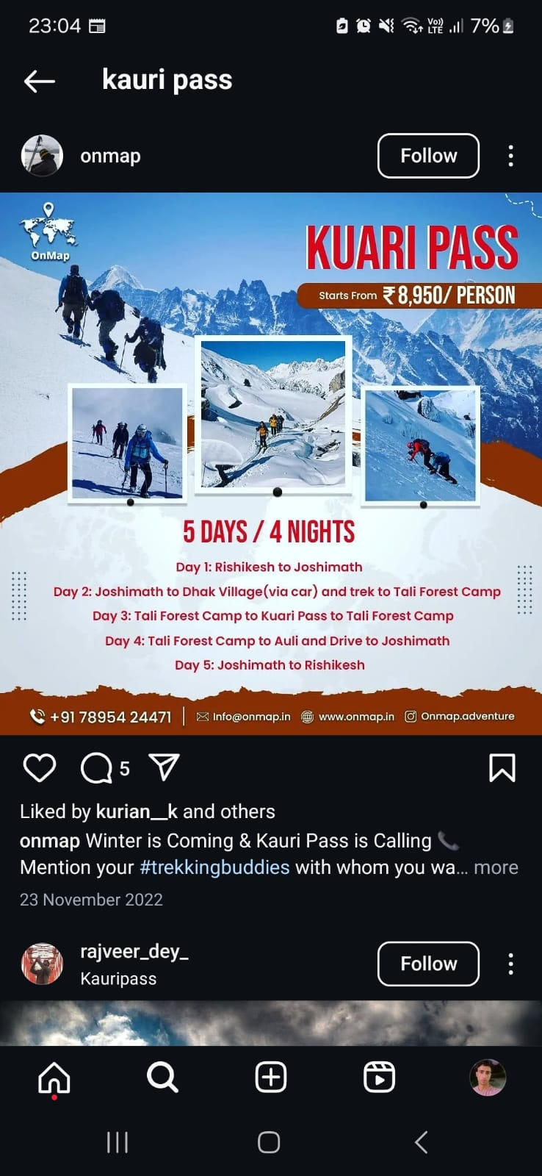
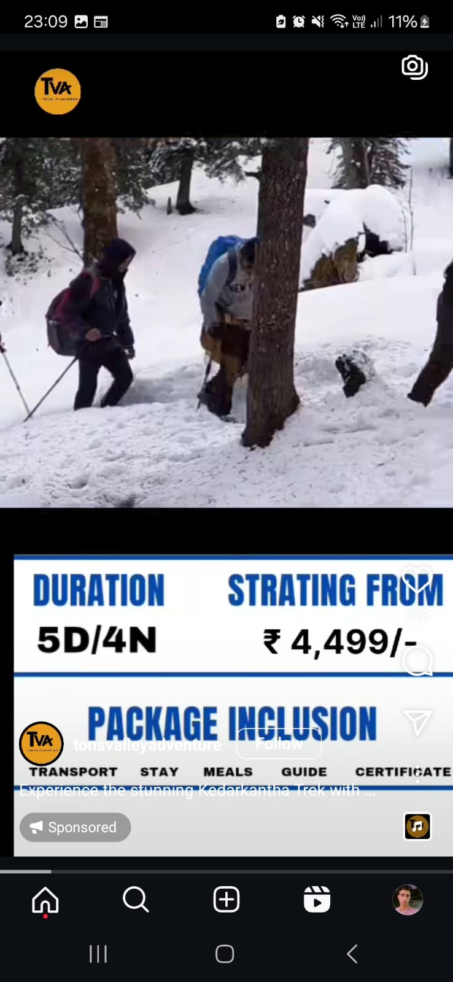
The Challenge of Comparing Tour Agencies & Activity Prices :
Lack of Transparent Pricing
No standardized way to compare tour agency prices.
Hidden charges and unclear cost breakdowns create confusion.
Difficulty in Finding the Right Tour Operator
No central platform to compare agencies for trekking, adventure, and cultural tours.
Travelers struggle to find the best service provider for their needs.
Limited Access to Verified Reviews & Reliable Information
Many agencies lack verified customer feedback and authentic reviews.
Increases risk of scams and poor service quality.
Inefficient Communication & Booking Process
No direct chat or quick inquiry options.
Time-consuming process of calling/emailing multiple agencies.

Slide 8
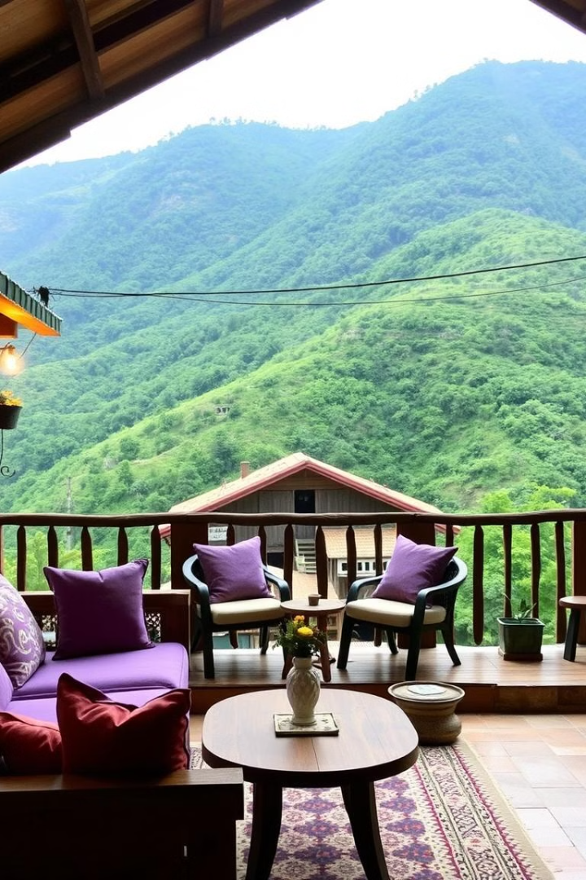
Travel Sathi: Connecting Travelers and Villages
1
Explore Villages and Homestay Booking
2
Tour Agencies Price Comparison
Interactive village listings with detailed cultural insights. Homestay profiles with verified reviews and authentic experiences.
Comprehensive agency listings with transparent price structures. Price comparison tools for specific activities like trekking, cultural tours, or adventure sports.
3
Travel Dost (Traveler Matching)
Personalized traveler matching based on interests and destinations. Shared itineraries for social travelers to collaborate.

Slide 9
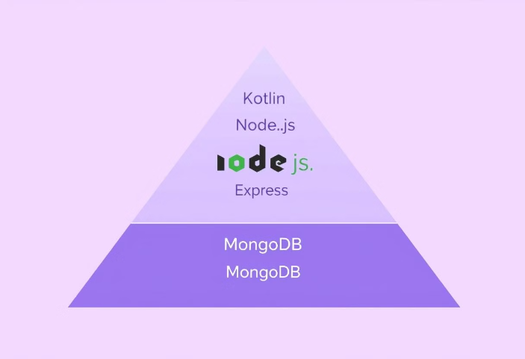


Technologies for Travel Sathi Development
Technologies to Be Used:
Frontend: Kotlin for a responsive and user-friendly mobile app experience.
Backend: Node.js and Express.js for a scalable server-side architecture.
Database: MongoDB for flexible, NoSQL database management.
API Integration: RESTful APIs for booking, price comparison, and traveler matching.
Other Tools: Firebase for authentication and cloud hosting.

Slide 10
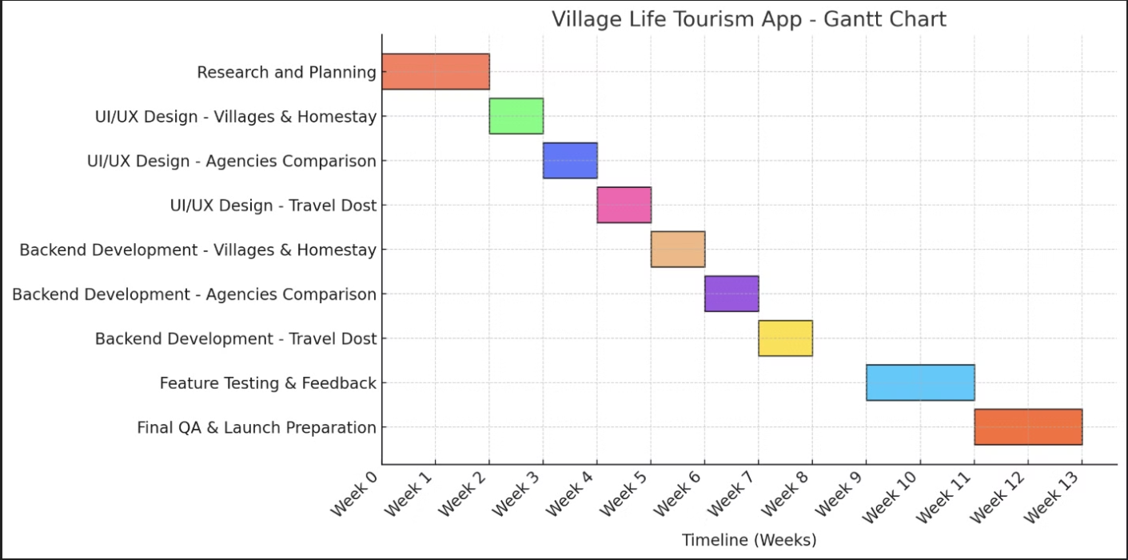
Project Timeline and Milestones

Slide 11
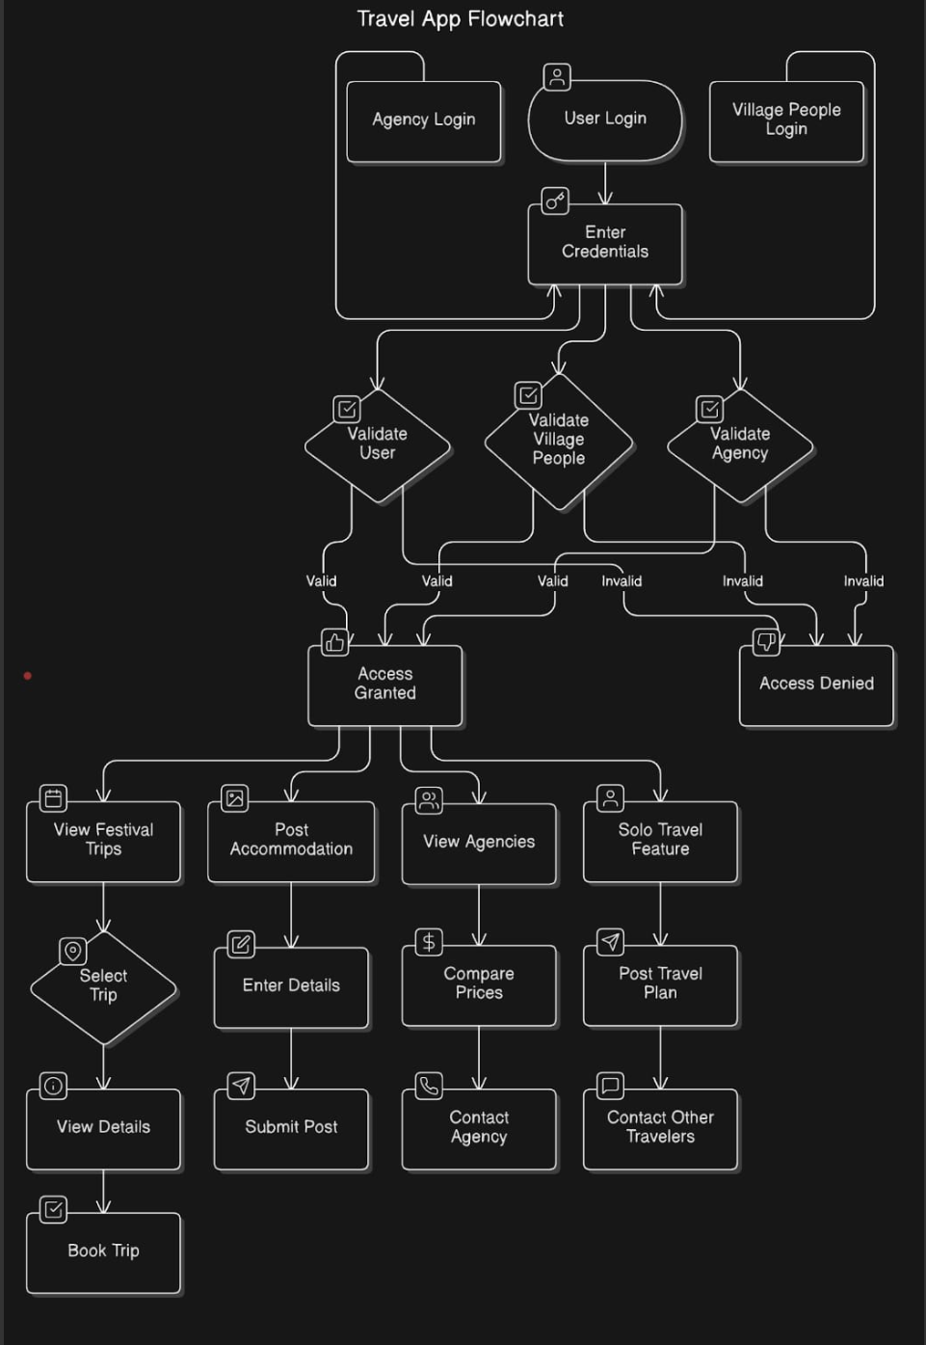
Flow Chart :

Slide 12
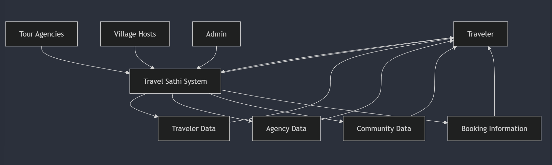
DATA FLOW DIAGRAM :
DFD ( Level 0) :-

Slide 13
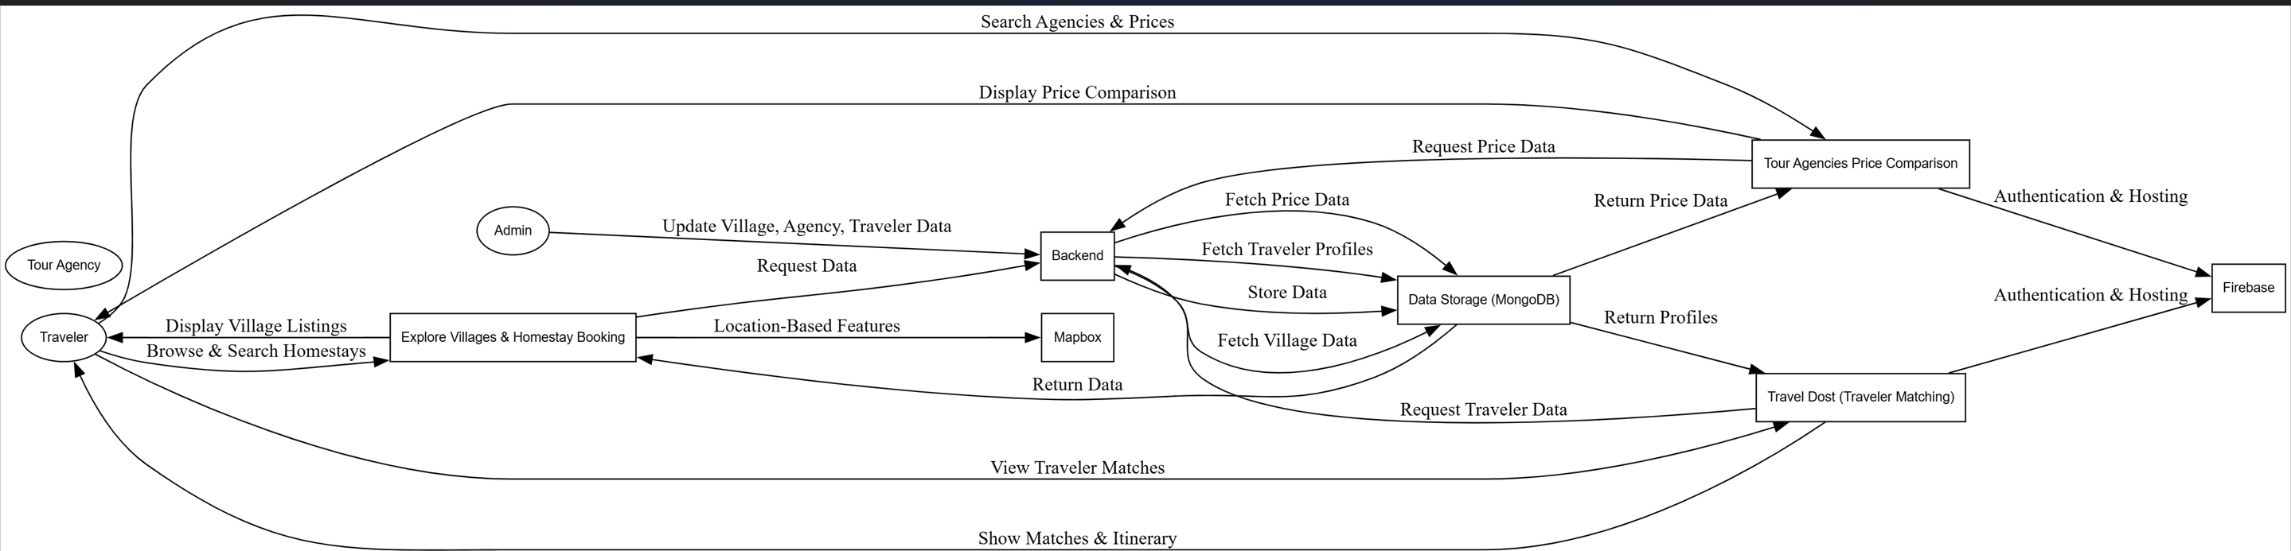
DFD (Level 1 )

Slide 14
Empowering Travelers Through Authentic Village Experiences
Revolutionizing rural tourism by creating a seamless bridge between travelers and authentic village experiences.
Personalized Experiences
Community Growth
Tailored travel planning with curated recommendations.
Strengthening local economies through sustainable tourism.
Informed Choices
Global Connection
A platform that empowers travelers with clarity and confidence.
Building a vibrant community of like-minded explorers.

Slide 15
THANK YOU !

